Slide 1
OLIST STORE ANALYSIS
PRESENTED BY
Shabdajit Lawhare

Slide 2
INTRODUCTION
Olist is an e-commerce technology company that acts as a large marketplace connecting retailers to major online marketplaces, enabling businesses to increase their sales without needing their own e-commerce presence. By managing software, marketplace contracts, and logistics, Olist provides a platform for small and large businesses to reach more customers, utilizing customer satisfaction surveys and anonymized sales data for analysis and improvement.
Olist offers a Software as a Service (SaaS) solution to retailers, providing them access to major Brazilian e-commerce platforms to sell their products. They manage the logistics for getting products from sellers to customers, streamlining the process for businesses. Olist acts as a large department store within the marketplaces, bringing together thousands of different sellers and their products. Olist collects customer satisfaction survey data after purchases, providing insights into the customer experience for sellers and for analyzing overall market trends.

Slide 3
OBJECTIVE
The objective of the Olist Brazilian E-Commerce is to provide a comprehensive look at the Brazilian e-commerce landscape to identify business opportunities and optimize strategies for growth and efficiency. It offers detailed insights into customer behavior, product performance, sales trends, and operational aspects, allowing analysts to understand consumer preferences, improve customer retention, and pinpoint areas for expansion within the market.
Analyze customer demographics, purchase frequency, and recency to segment customers and develop targeted marketing and engagement strategies.
Identify popular product categories and top-selling items to understand market demand and optimize product offerings.
Track monthly revenue, analyze revenue per product category, and identify top-performing states to understand financial performance and regional potential.

Slide 4
DATA COLLECTION AND PREPARATION
DATA SOURCE DETAILS:
Provided by : Team Leader Mr. B. Harish
Date Received : 07 September 2025
Delivery Method : Through Gmail.
DATA OVERVIEW:
Format – Excel .CSV
No. of Tables – 9
Table Names: olist_customers_dataset, olist_geolocation_dataset, olist_order_items_dataset, olist_order_payments_dataset, olist_order_reviews_dataset, olist_orders_dataset, olist_products_dataset, olist_sellers_dataset, product_category_name_translati

Slide 5
DATA LINEAGE & TRANSFORMATIONS:
I have assigned proper data type of each and every columns.
Removed Unwanted Columns.
Added Custom Calculated Columns.
I have done with merging the tables which consists all Product details.
Created relationships between each and every tables.
The type of Relationship is one to Many.
Replaced Nulls in Measure Columns with 0.
Replaced Nulls in dimension Columns with NA.

Slide 6
TOOLS
Excel – Used for data cleaning in power query tab , create Relationships in power pivot and Finally For Data Visualization.
Power BI – A widely Used tool for Creating Data Visualization and get Hidden insights To improve the business.
SQL- Data Retrieval and Extraction: SQL allows analysts to Query data bases and extract specific subsets of data based on defined criteria.
Tableau – It is used to quickly transform complex data into easily understandable, interactive, and shareable visual dashboards and reports, which helps them discover trends, gain insights, and make data-driven business decisions.

Slide 7
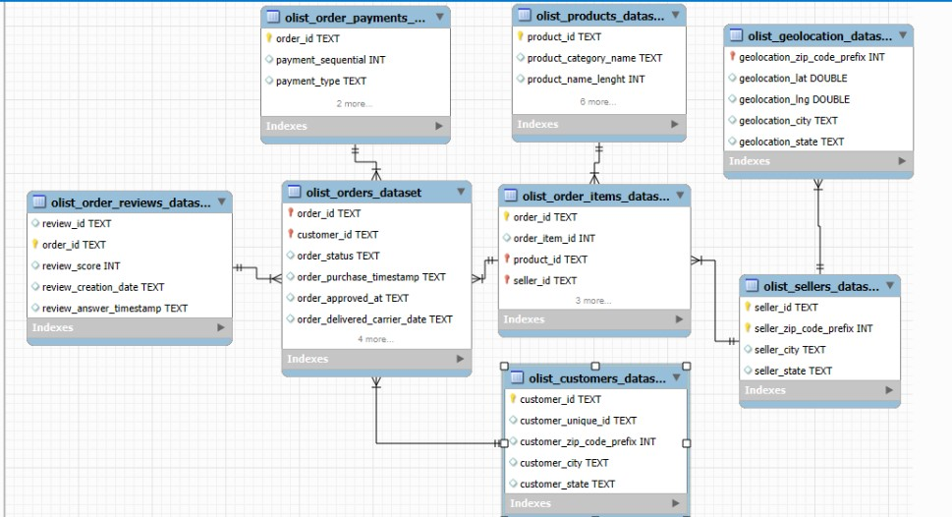
RELATIONSHIP BETWEEN TABLES

Slide 8
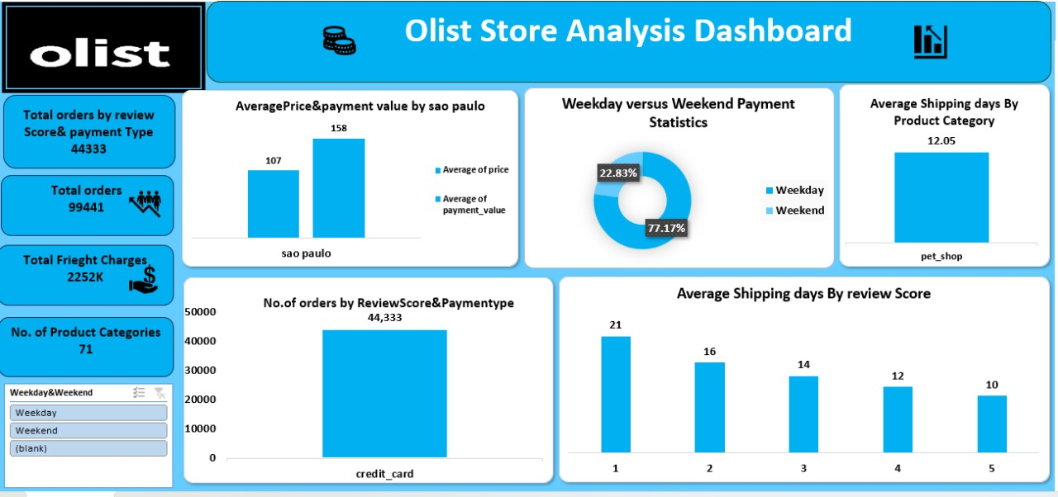
DASHBOARD DESIGNS-EXCEL DASHBOARD

Slide 9
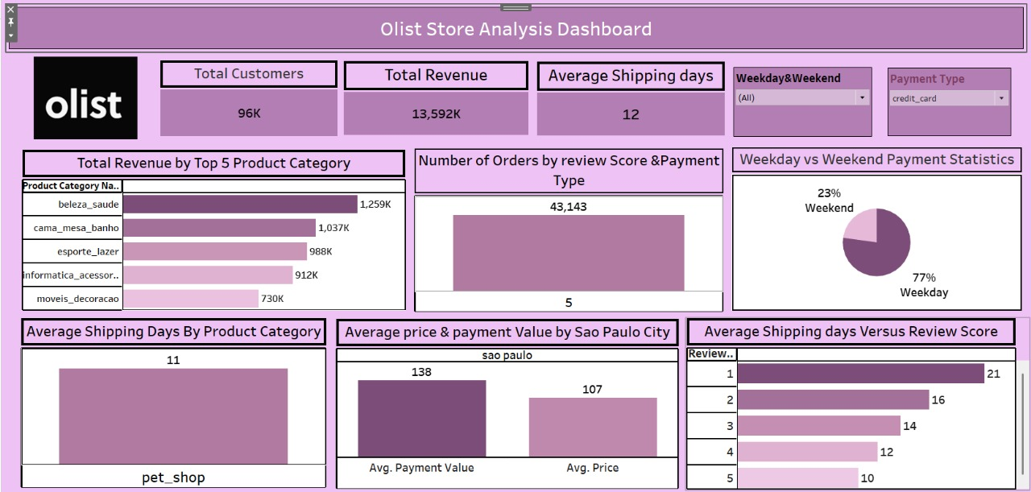
TABLEAU DASHBOARD

Slide 10
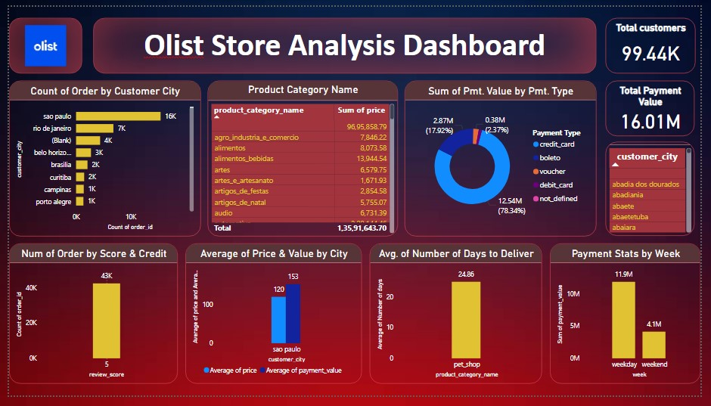
POWER BI DASHBOARD OVERVIEW

Slide 11
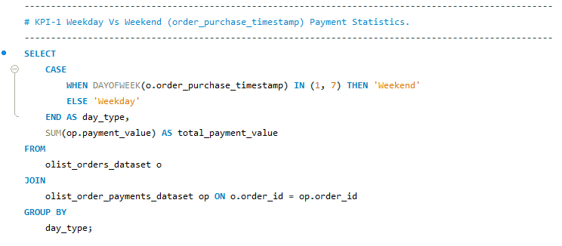
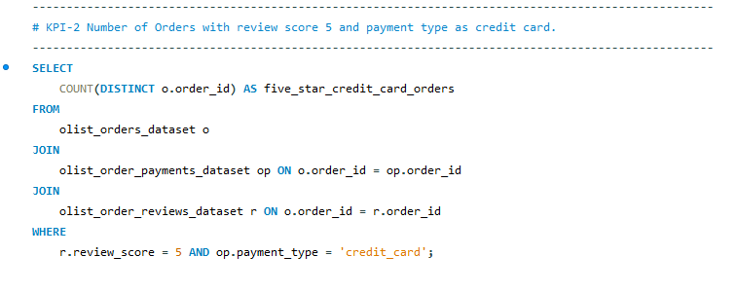
SQL QUERIES

Slide 12
